Slide 1
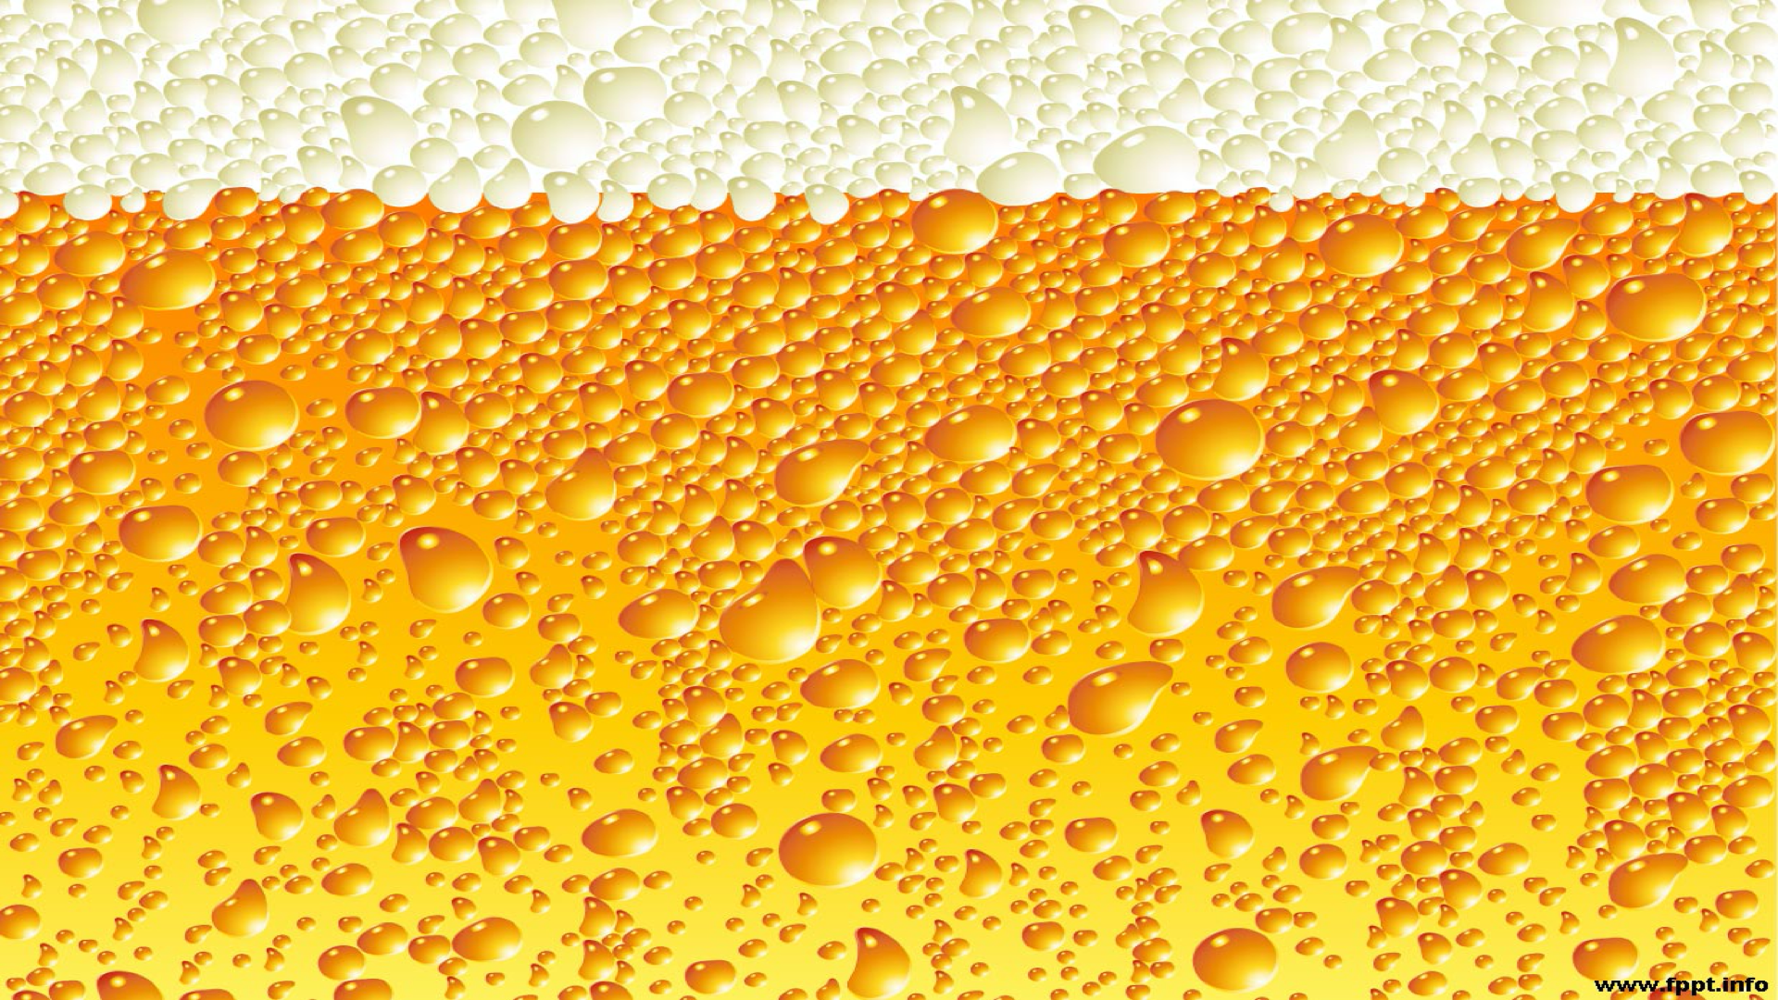


Presenters:
Case Study:
Beers and Breweries
Eric Romero
Samuel Onalaja
Amber Lea Clark

Slide 2
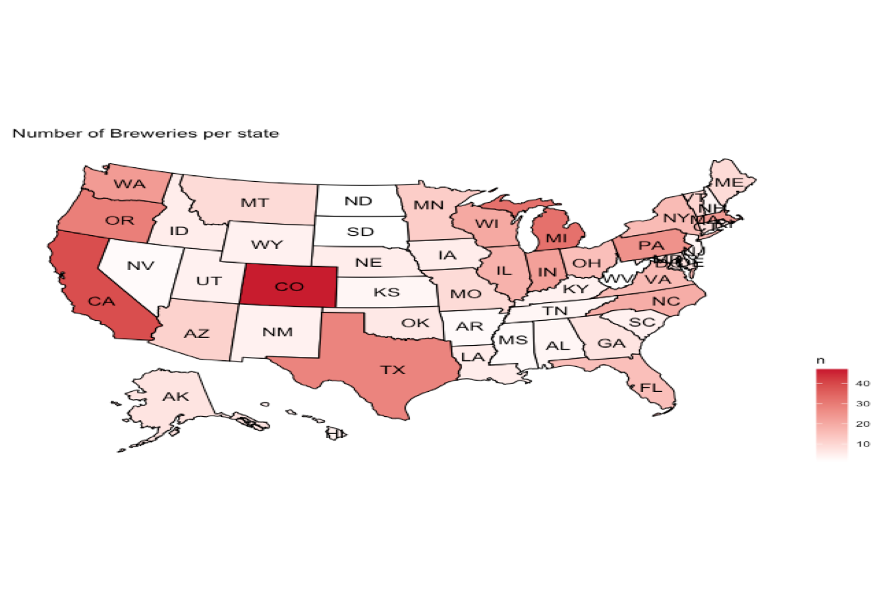

Slide 3
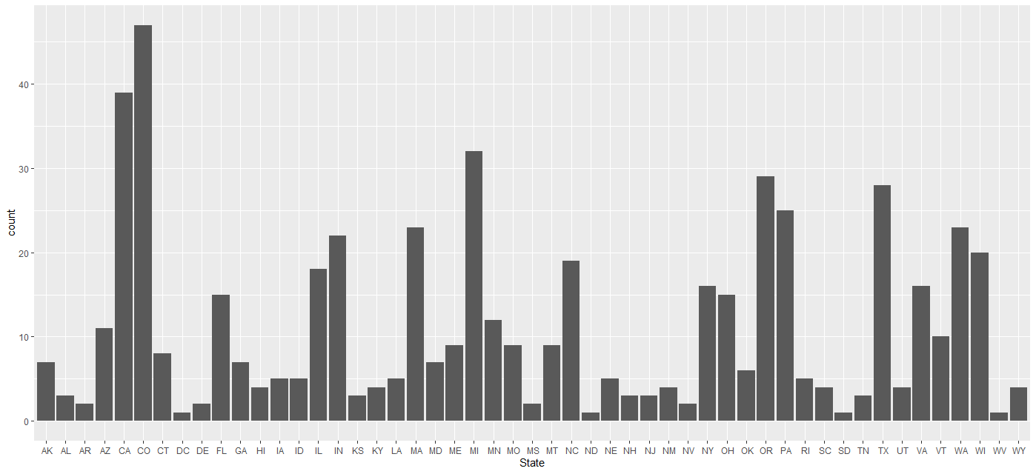
Breweries by State

Slide 4
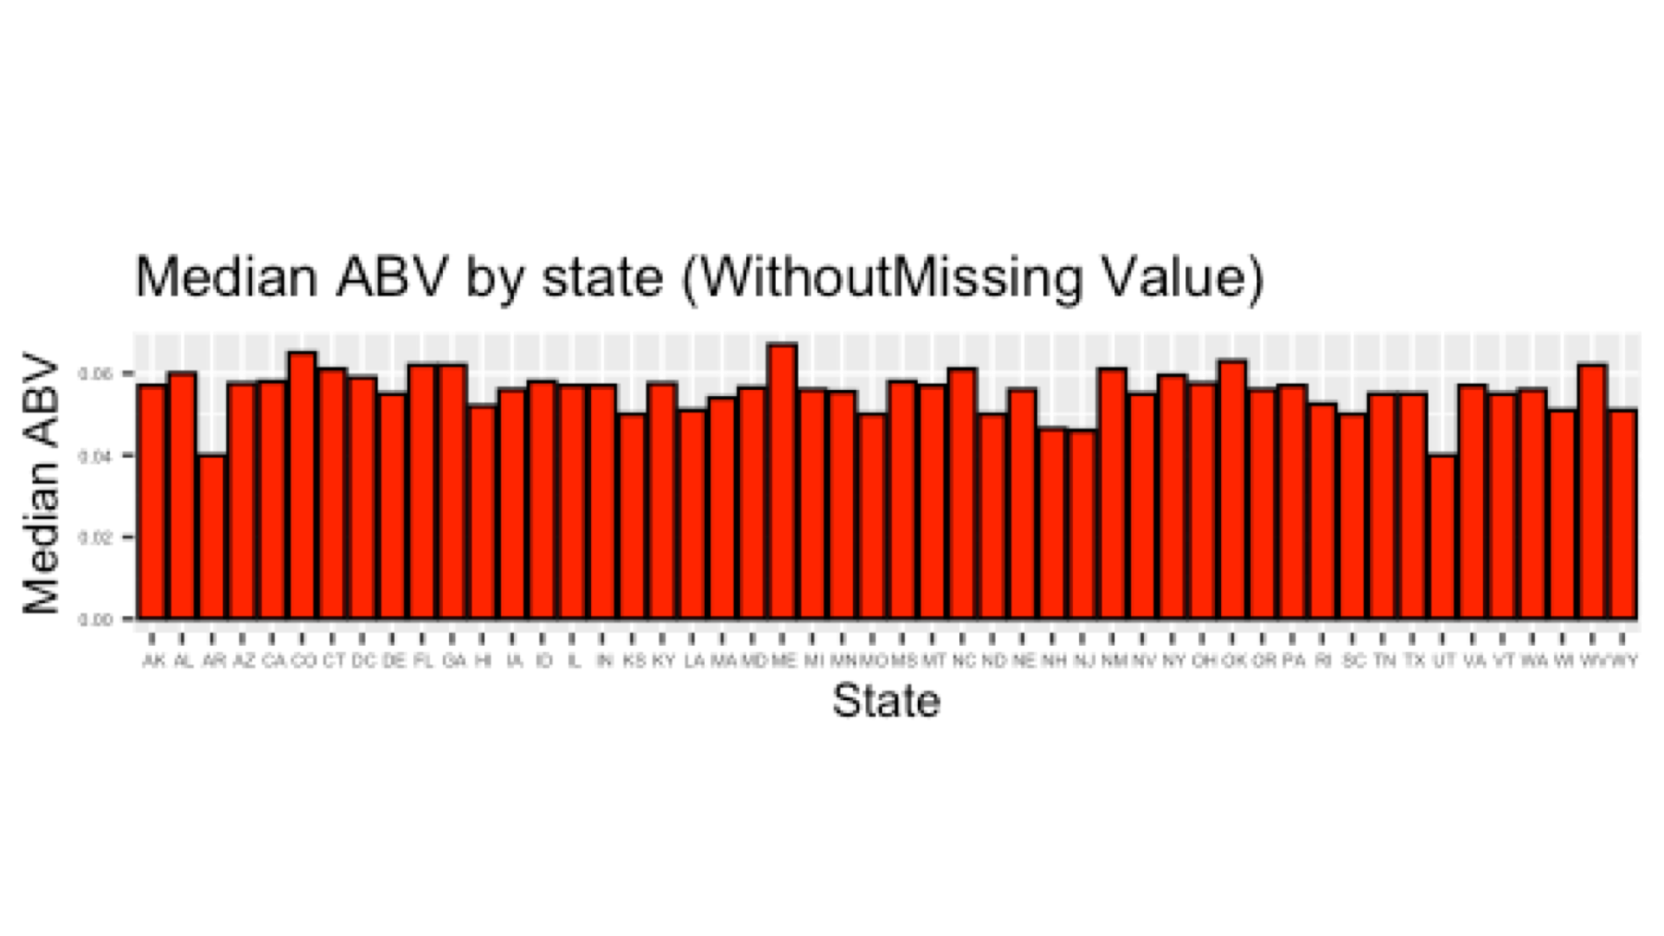
State Median for Alcohol by Volume (ABV)

Slide 5
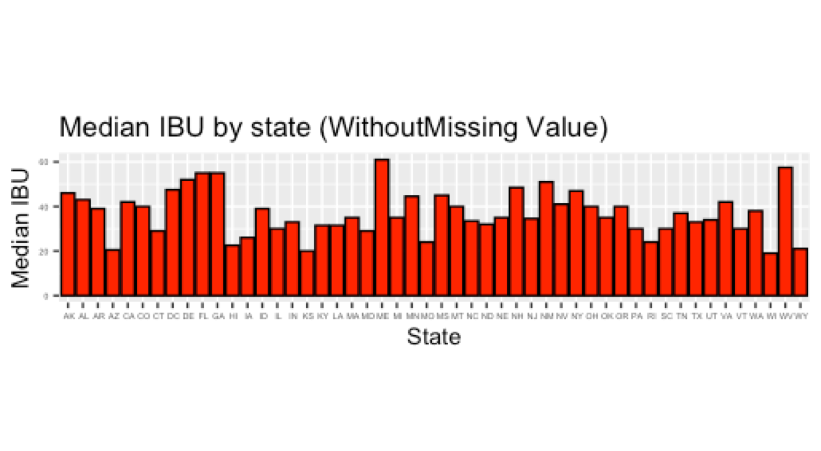
State Median for International Bitterness Units (IBU)

Slide 6
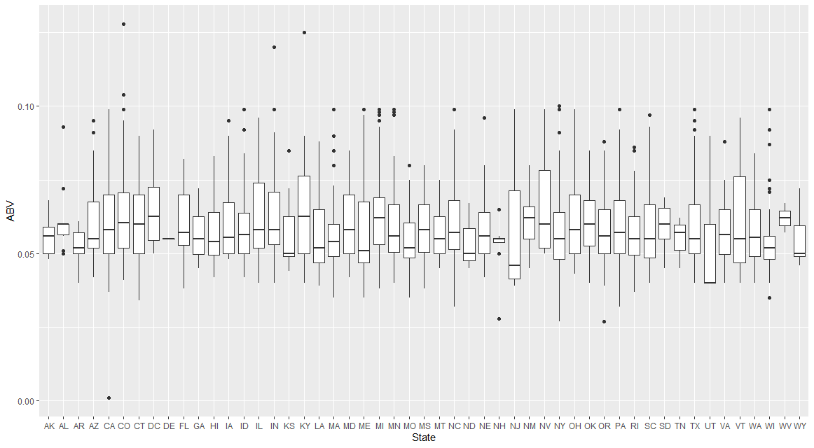
ABV Variance by State

Slide 7
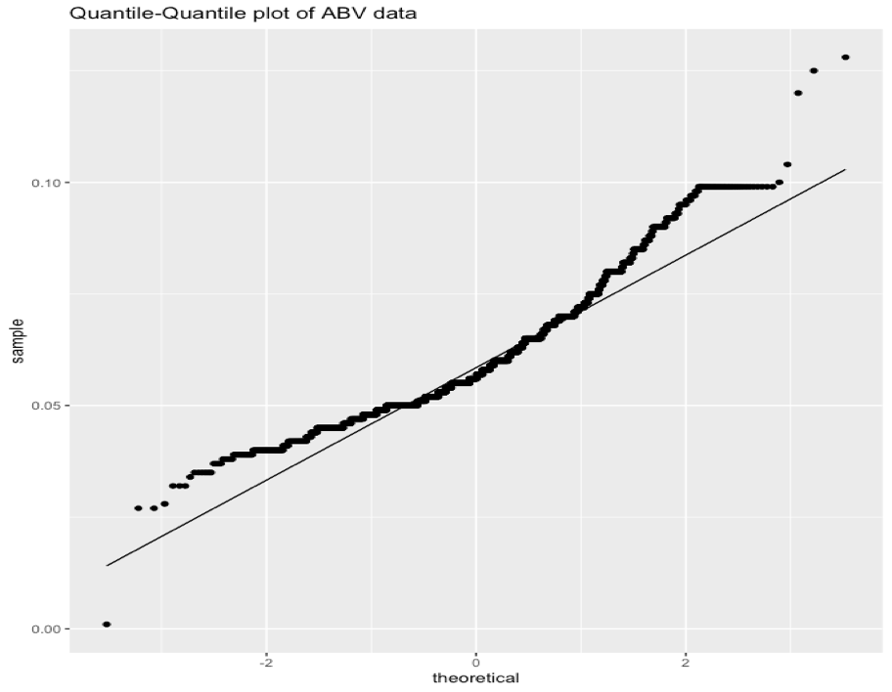
•The mean value at 0.05977 is slightly higher than the median value at 0.05600, which indicates a right skewed distribution.
•From the upward curve in this plot, we infer that the data are somewhat skewed. The obvious discontinuities at the ends of the curve are an indication that the ABV values have a few outliner.

Slide 8
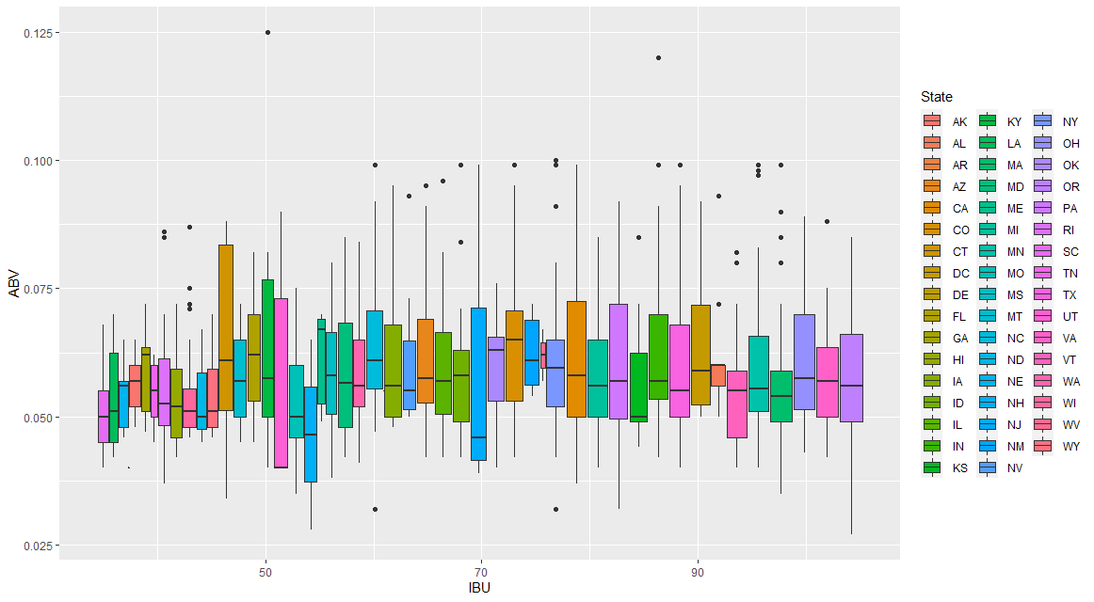
ABV and IBU Variance by State

Slide 9
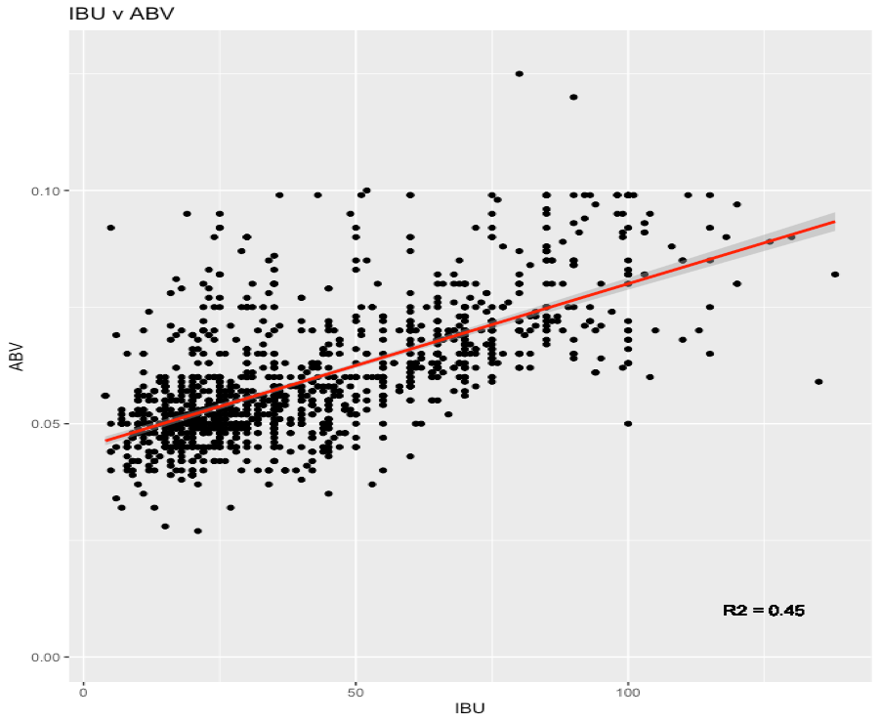
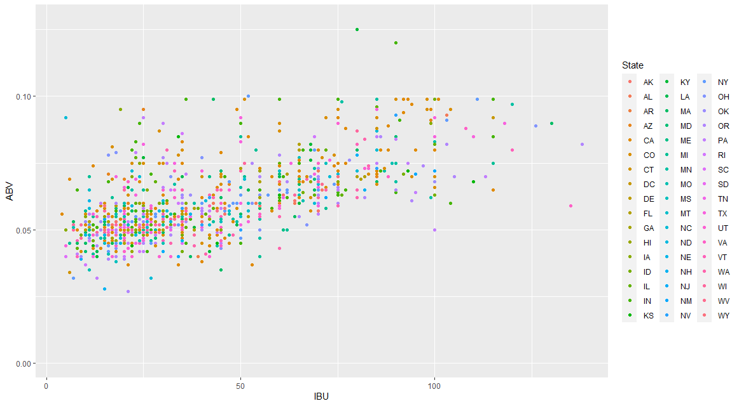
ABV and IBU by State
The plot Shows a positive relationship between IBU and ABV

Slide 10


Highest ABV and IBU by State
Georgia has the highest ABV of .128
Oregon has the highest IBU of 138

Slide 11
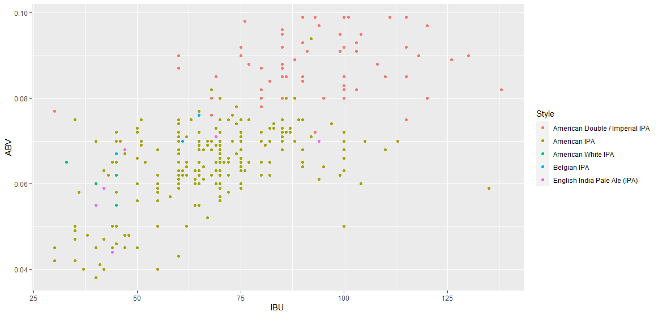
KNN Chart for IPA Styles (ABV and IBU)

Slide 12
Methodology
Two data set were provided an we added a third one:
•Beers
•Breweries
•State census data
We started by performing exploratory data analysis on the data sets after they were merged to provide a full overview of the Breweries and beers .
We identify states that appears to be underserved and also the variability of the alcohol contents and bitterness and make recommendations on the improvement that can be make for the growth of the breweries industry

Slide 13
Data Summary
Variables Characteristics
Name: Name of the beer.
Beer_ID: Unique identifier of the beer.
ABV: Alcohol by volume of the beer.
IBU: International Bitterness Units of the beer.
Brewery_ID: Brewery id associated with the beer.
Style: Style of the beer.
Ounces: Ounces of beer.
Brew_ID: Unique identifier of the brewery.
Name: Name of the brewery.
City: City where the brewery is located.
State: U.S. State where the brewery is located.

